Slide 1


DEPARTMENT OF COMPUTER SCIENCE & ENGINEERING(Data Science)
PROBLEM DEFINATION SEMINAR ON
“Sentiment Analysis of Financial Markets”
MAJOR PROJECT
PROJECT GUIDE: Prof. Jayshri Harde
DATE: 18/11/24
PROJECT MEMBERS:
1)Tarandeep Plaha
2)Sahil Bhusari
3)Solomon Alexander
4)Kaustubh Mate

Slide 2
Content
Contents:-
Introduction
Problem Statement
AIM
Objectives
Domain Information and Knowledge
ER Diagram
Languages and Platform Used
Application of Concept Used
References

Slide 3
INTRODUCTION
Sentiment analysis is crucial in financial markets to gauge investor opinions and market trends.
This project extends the previous "Sentiment Analysis of Financial Markets" system by incorporating technical and fundamental analysis.
The aim is to enhance the system's ability to assess sentiment in real-time from sources like news articles, social media posts, etc.

Slide 4
PROBLEM STATEMENT
The financial market is highly influenced by news, social media trends, and investor sentiments.
Traditional analysis methods often overlook the dynamic nature of these sentiments.
The project aims to solve the problem of accurately assessing sentiment in real-time and integrating it with technical and fundamental analysis to provide a holistic market view.

Slide 5
AIM
Goal:
Develop a sentiment analysis system for the financial market that uses technical and fundamental analysis to provide real-time insights from news, social media, and other textual data.

Slide 6
OBJECTIVES
Enhance Interface: Improve the user interface for a better experience.
Dynamic Graphs: Use Yahoo Finance to create graphs that update in real-time.
Automated Input Clearing: Automatically clear inputs after each use for better usability.
Improve Aesthetics: Make the dashboard more visually appealing and user-friendly.
Real-Time Sentiment Analysis: Analyze sentiment in real-time using advanced algorithms.
Technical and Fundamental Analysis: Combine these analyses for a comprehensive market assessment.

Slide 7
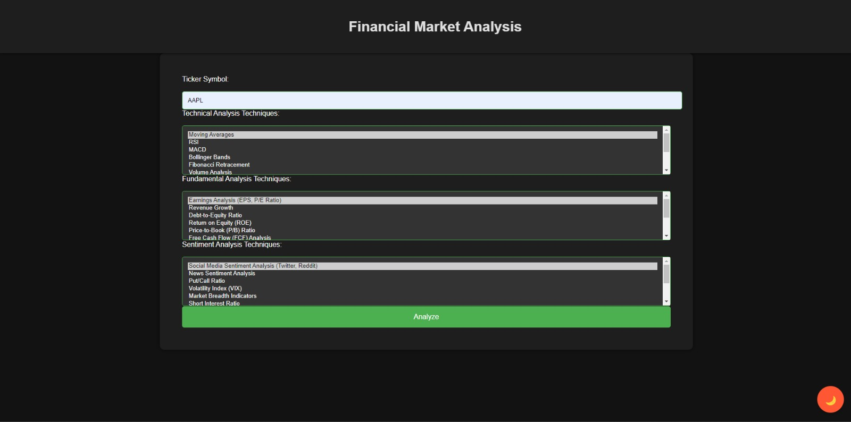
Project Images

Slide 8
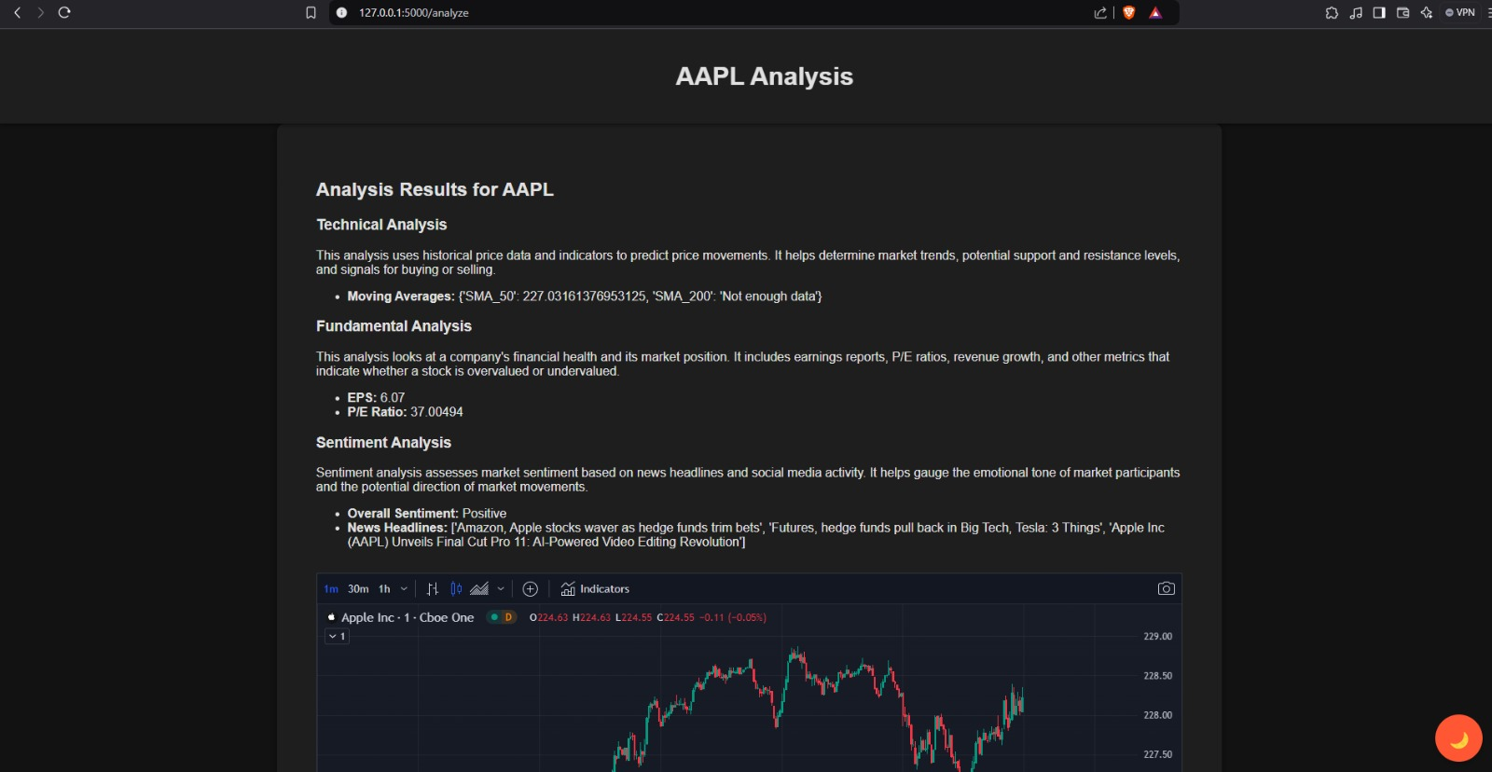
Project Images

Slide 9
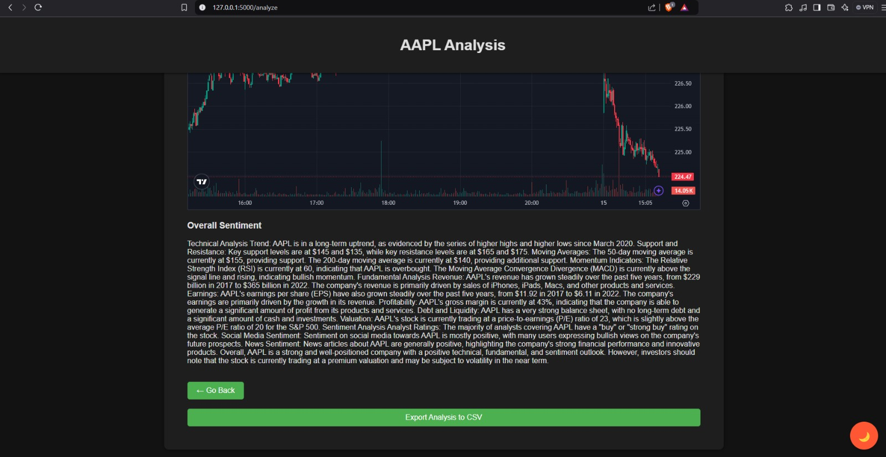
Project Images

Slide 10
DOMAIN INFORMATION & KNOWLEDGE
The financial market is complex, influenced by multiple factors including economic indicators, investor behavior, and global events.
Sentiment analysis extracts subjective information from text data, which is crucial for predicting market movements.
Integrating technical (e.g., Moving Averages, RSI) and fundamental (e.g., earnings reports) analysis makes sentiment analysis more reliable and actionable.

Slide 11
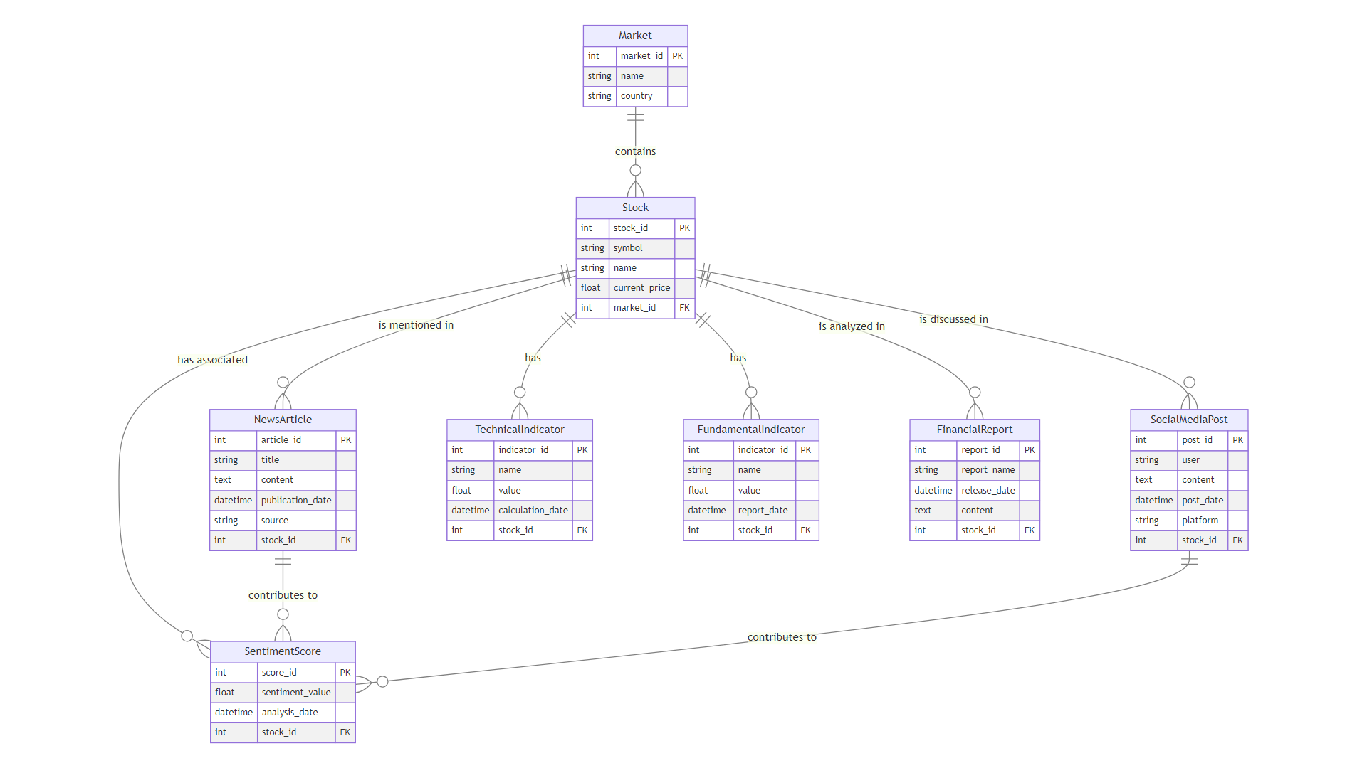
ER - DIAGRAM

Slide 12
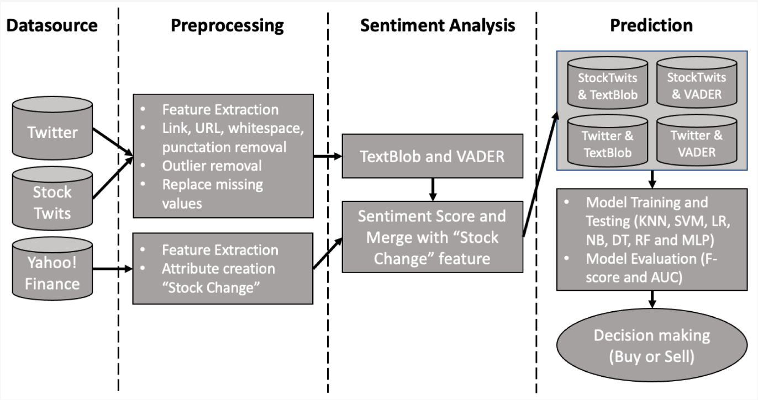
DIAGRAM

Slide 13
LANGUAGES AND PLATFORM USED
Languages:
Python (for sentiment analysis and data processing)
Platforms:
Yahoo Finance API (for real-time financial data)
Jupyter Notebook/Google Colab (for development)
Libraries:
Yahoo Finance (for Live Data)
Scikit-learn (for sentiment analysis)
Matplotlib, Seaborn (for data visualization)

Slide 14
APPLICATION OF CONCEPTS USED
Sentiment Analysis: NLP techniques to extract sentiment from text data.
Technical Analysis: Indicators like Moving Averages, RSI (Relative Strength Index), MACD (Moving Average Convergence Divergence) for market trend assessment.
Fundamental Analysis: Analysis of financial statements and reports for broader market insights.
Data Visualization: Dynamic Graphs for intuitive data representation.

Slide 15
REFERENCES
Academic Papers:
Bollen, J., Mao, H., & Zeng, X. (2011). Twitter mood predicts the stock market.
Mittermayer, M. A., & Knolmayer, G. F. (2006). Text mining systems for market response to news.
Technical Resources:
Yahoo Finance API documentation for real-time data.
Power BI/Tableau documentation for data visualization techniques.
NLTK(Natural Language Toolkit) and VADER(Valence Aware Dictionary and Sentiment Reasoner) documentation for sentiment analysis.

Slide 16
THANKYOU

